Slide 1
Lanark County Community Justice
Using A Trauma-Informed Approach
613-264-1558 or 1-888-264-1558
Notes:
How many of you have heard of trauma-informed care or a trauma-informed approach?
Have any of you taken specific training in this? Please feel free to add your expertise throughout this discussion, and if you haven’t had specific training, please feel free to add your ideas and lived experiences because so much of this is generally good common sense with a large dose of compassion thrown in

Slide 2
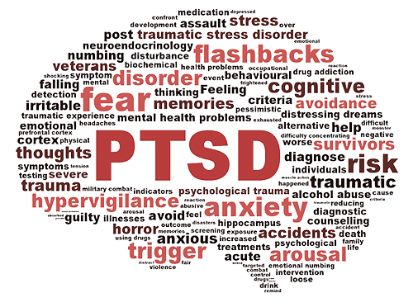
Lanark County Community Justice
What is trauma?
Does every person who experiences a traumatic event become traumatized?
How do we know someone has been traumatized?
613-264-1558 or 1-888-264-1558
Notes:
Trauma is a wound that injures us emotionally, psychologically, spiritually and possibly physiologically
It is usually something that comes from the outside but the impact is often internal
We are not talking about the event, but what happens within the nervous system as a result of the whole mind-body event
Who gets to decide if someone is experiencing trauma?

Slide 3
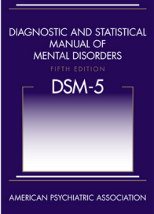
Lanark County Community Justice
DSM-5 Definition of Trauma
person exposed to actual or threatened death, actual or threatened serious injury, actual or threatened sexual violence
direct exposure or direct witnessing
Indirect exposure by learning of threat or injury to a loved one or repeated extreme exposure to details (i.e. vicarious trauma in professionals)
613-264-1558 or 1-888-264-1558
Notes:
Diagnostic and Statistical Manual of Mental Disorders (DSM–5) 2013
https://psychiatry.org/psychiatrists/practice/dsm
The DSM can sometimes be a useful tool but it is not the definitive method for determining whether or not we should be applying a trauma-informed lens on our interactions with people. It has it’s purposes and it’s limits

Slide 4
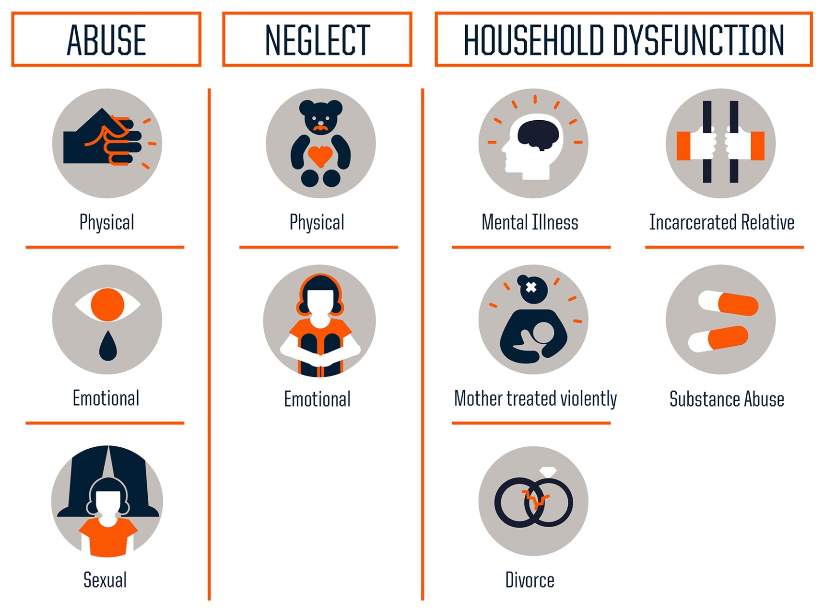
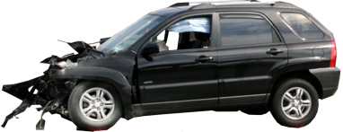
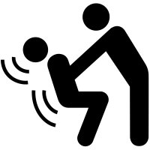
Lanark County Community Justice
Some Types of Trauma We’re Likely to Encounter
Developmental Trauma: ACEs
Shock Trauma: One-time or single incident
Relational Trauma: from another person
613-264-1558 or 1-888-264-1558
Notes:
ACE’s- you’ll be getting a handout on these for more detail on the ACE score and the outcomes generally associated with those scores. It is critical to remember though that nothing happens in a vacuum and the resiliency of the person as well as other supports and strengths in their lives are REALLY important factors in these outcomes. And here’s where this gets REALLY important for us, because WE ARE THOSE FACTORS!
Which one of these is worse? (Trick question because we do not get to decide that for someone else!)

Slide 5
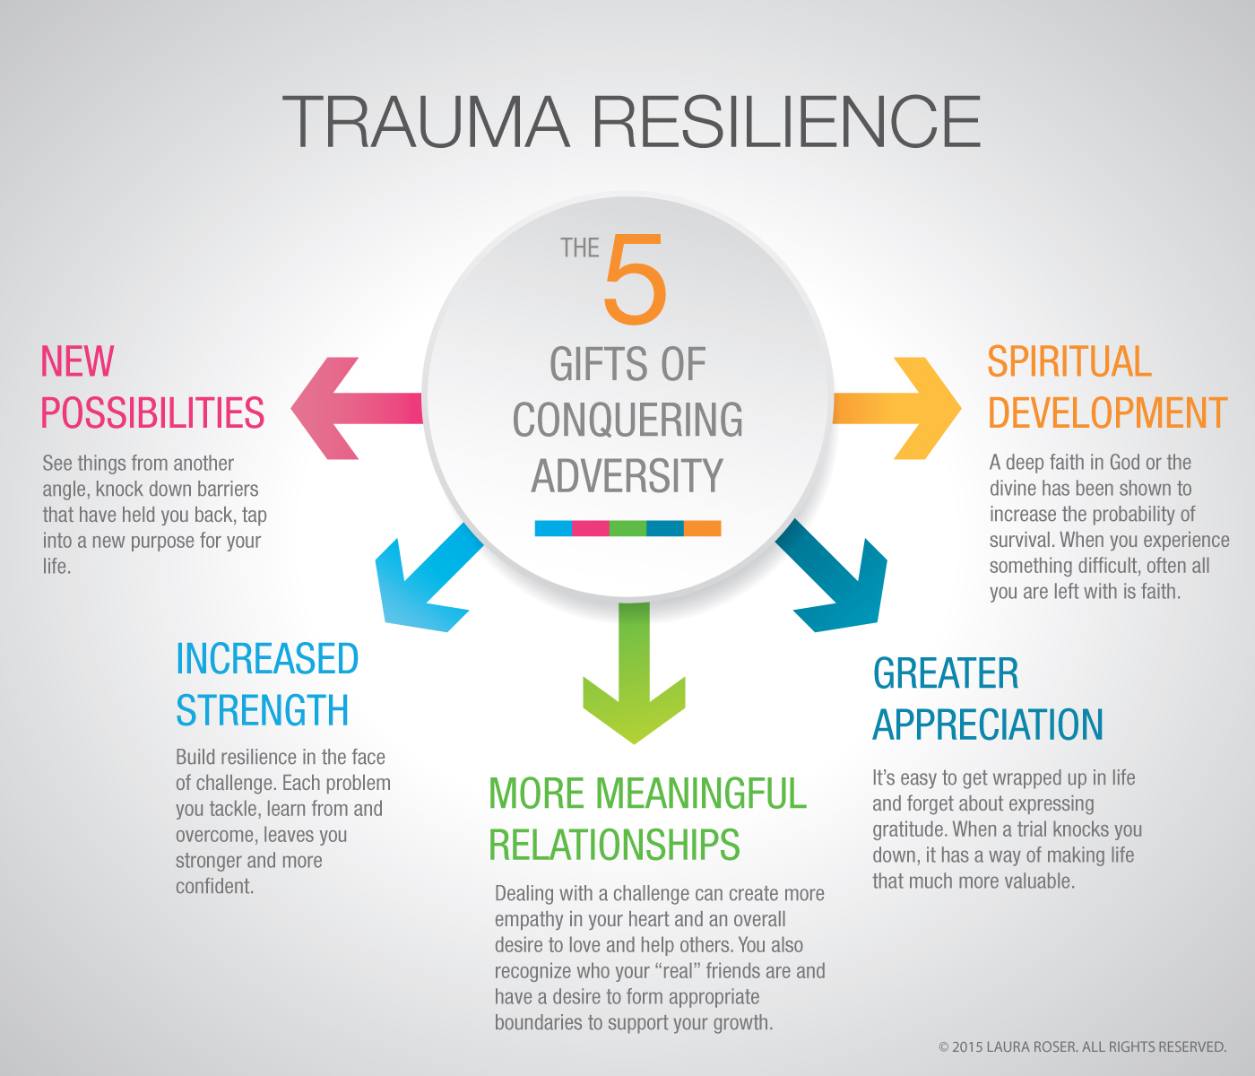
Lanark County Community Justice
Traumatic Growth:
Post-traumatic growth is also possible in lieu of or alongside post-traumatic stress.
Transformed view on life
Expanded capacity
Increased resiliency
613-264-1558 or 1-888-264-1558
Notes:
Before we get into some of the more challenging impacts of trauma, we also have to recognize many people can also experience something positive from trauma.

Slide 6
Lanark County Community Justice
Initial Trauma Response:
Become more alert
If we sense relative safety at this point, we can take in the support of others
Secondary Trauma Response:
Hyper-arousal:
Mobilization (flooding of emotion)
Fight
Flight
Hypo-arousal
Immobilization (can seem like apathy)
Freeze
Shut-down
Recuperation
Regulation of nervous system
613-264-1558 or 1-888-264-1558
Notes:
Important to remember these are completely normal adaptive behaviours of the nervous system in the immediate aftermath or onset of a traumatic event
So if our activation is getting higher and higher but we cannot escape the threat, the parasympathetic nervous system takes over and we can completely shut down. Note, we don’t have voluntary control over the parasympathetic nervous system. These are not reactions designed to “get attention”, to “be overdramatic”, or “try to make you feel sorry” for someone. MYTHS!
This is meant to be a short term response to help us adapt and survive. Most of our problems as people comes from the fact we can’t always move out of this response in the short term and this becomes a pretty big toll on the emotional, mental, physical and spiritual health of the person.

Slide 7
Lanark County Community Justice
DSM-5 4 Clusters of Symptoms
Re-experiencing (flashbacks…)
Arousal (heart racing, sweating, trembling….)
Avoidance (numbing out, forgetting…)
Persistent negative cognition or mood (dissociating…)
613-264-1558 or 1-888-264-1558
Notes:
What happens if someone we’re working with does not display any of these symptoms? Does that mean they are not experiencing/have not experienced trauma?

Slide 8
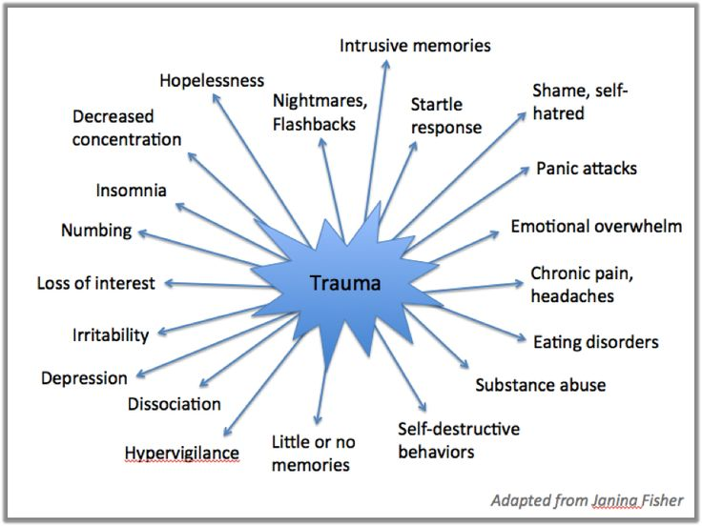
Lanark County Community Justice
613-264-1558 or 1-888-264-1558
Notes:
If we think to our own experiences, we can probably relate to some or all of these behaviours as they relate to trauma.
What we can probably also relate to is our ability to sometimes cope and sometimes not. To sometimes manage these behaviours when we’re amongst others, and sometimes not.
It is really important to remember that even if someone “seems fine” to us, that may not be the reality for that person all the time.
Whiteboard Activity: Let’s put these behaviours into the symptom clusters and add any we think may be missing (i.e. think of your own natural reactions to big events)
Let’s reflect a bit on what you personally find helpful if you’re ever experiencing any of these impacts. Note how we all have many different things that help or don’t help and it’s perfectly normal for those things to be unique to us.
If these impacts persist past the “acute” phase (clinically determined at 3 months) we now call it “PTSD” Post-traumatic Stress Disorder (can be delayed)

Slide 9
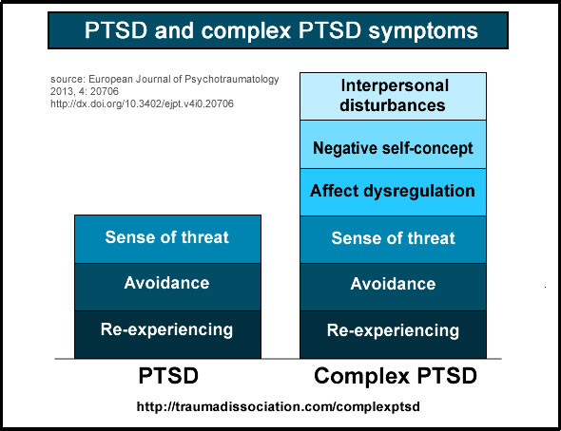
Lanark County Community Justice
Complex Post-Traumatic Stress:
Not really an “official” diagnosis
Common phrase to describe more complex symptoms from prolonged relational trauma
613-264-1558 or 1-888-264-1558
Notes:
Which one of these situations would require us to use our trauma-informed lens in responding to them? (BOTH)
Always remember it is not up to us to judge how big or small someone’s impacts from trauma are, and we cannot know that from just the behaviours we are privvy to, always something more going on behind the curtain!
Certainly we can understand why the added components of betrayal/trust/attachments etc in relational trauma can be more challenging to process.
There are a LOT of “shoulds” when it comes to relationships and for people living with relational trauma, the universe of difference between the “should” and the “reality” is a whole extra layer of trauma. i.e. families should love each other, should never hurt each other etc…

Slide 10
Lanark County Community Justice
Longer Term or Ongoing Impacts of Trauma
Intrusion and Re-experiencing
Intrusive thoughts and/or images
Repetitive play depicting impact
Dissociative flashbacks
Nightmares
Retelling bits/parts of the story over and over
Physical reactivity (nausea, shaking, headaches, high startle response…)
Avoidance
Internal: thoughts, feelings
External: places, people, activities
Negative Alterations in Affect and Cognition
Disconnection
Persistent negative affect (fear, guilt…)
Inability to remember parts of the experience
Persistent negative self-blame/hate
Persistent negative beliefs about the world
Disorientation, fogginess
Inability to feel joy (or anything sometimes)
613-264-1558 or 1-888-264-1558

Slide 11
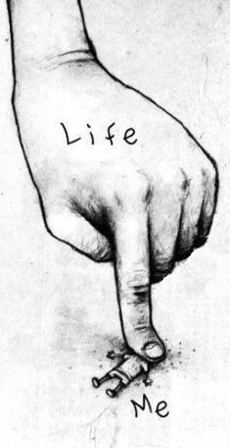
Lanark County Community Justice
Longer Term or Ongoing Impacts of Trauma
Hyper-arousal and Reactivity
Hypervigilance, sleep disturbances
Difficulty concentrating and focussing
Irritability, aggressive, reckless behaviour
Psychological and Emotional Symptoms
Fear and anxiety about the symptoms and impact
Self-blame, guilt, shame, feeling damaged or broken
Addictions and compulsive coping patterns
Sense of inferiority and/or isolation
613-264-1558 or 1-888-264-1558

Slide 12
Lanark County Community Justice
Longer Term or Ongoing Impacts of Trauma
Social and Relational Symptoms
Not trusting self or others
Hyper-vigilance: waiting to be disappointed, hurt, blamed, attacked, abandoned
Children- may have regression behaviours (thumb sucking, bed wetting, clinging), aggressive or oppositional behaviours
Indirect attempts to communicate and get needs met- has not been safe in the past
Difficulty with boundaries: difficulty saying no, feeling easily manipulated, too trusting/never trusting
613-264-1558 or 1-888-264-1558

Slide 13
Lanark County Community Justice
Some Strategies to Support A Victim of Trauma
Stay calm and grounded yourself, have clear boundaries
Work collaboratively (always remember you are NOT driving their bus!)
You do not get to decide how traumatic (or not) an event/experience was for someone else. That is a judgement call and we do not get to make judgements
Check your assumptions, be aware of your beliefs and biases
Throw out all your ideas about pace and what reactions/recovery/healing “should” look like
Understand the difference between pity and compassion/empathy
Do not be afraid of BIG feelings or silence
Believe them. You are not in a court of law and we do not need proof “beyond a reasonable doubt” to believe that something big happened to this person.
613-264-1558 or 1-888-264-1558

Slide 14
Lanark County Community Justice
Some Strategies to Support A Victim of Trauma
Find out what tools/strategies help them feel rooted in the PRESENT (these can be different for everyone)
Deep breathing
5 senses (describe 5 things you see, 4 things you feel, 3 things you hear…)
Ear lobe or pulse point pressure
Pushing feet into the ground, hand firmly on wall/table
Gentle eye contact and verbal affirmations “I am safe. I am here with you in this room and I am safe. I am sitting in this chair in this room with you and I am safe….”
Drink a hot tea
Allow people to judge their own mistakes without shutting them down or agreeing/commenting
Recognize their resistance, strengths and resiliency
613-264-1558 or 1-888-264-1558

Slide 15
Lanark County Community Justice
One of the most important elements of being Trauma-Informed is recognizing trauma is everywhere and anyone who has experienced a trauma is at a higher risk of being re-traumatized every time they interact with us
Prevalence of Trauma
Promote sense of safety
Foster trust and compassion
Offer as much choice as possible
Pillars of A Trauma-Informed Approach
613-264-1558 or 1-888-264-1558
Notes:
Be aware of the underlying vulnerability that exists in people who come into contact with a social service

Slide 16
Lanark County Community Justice
Interview Techniques Useful For Use with Victims and Survivors of Crime or Trauma
613-264-1558 or 1-888-264-1558

Slide 17
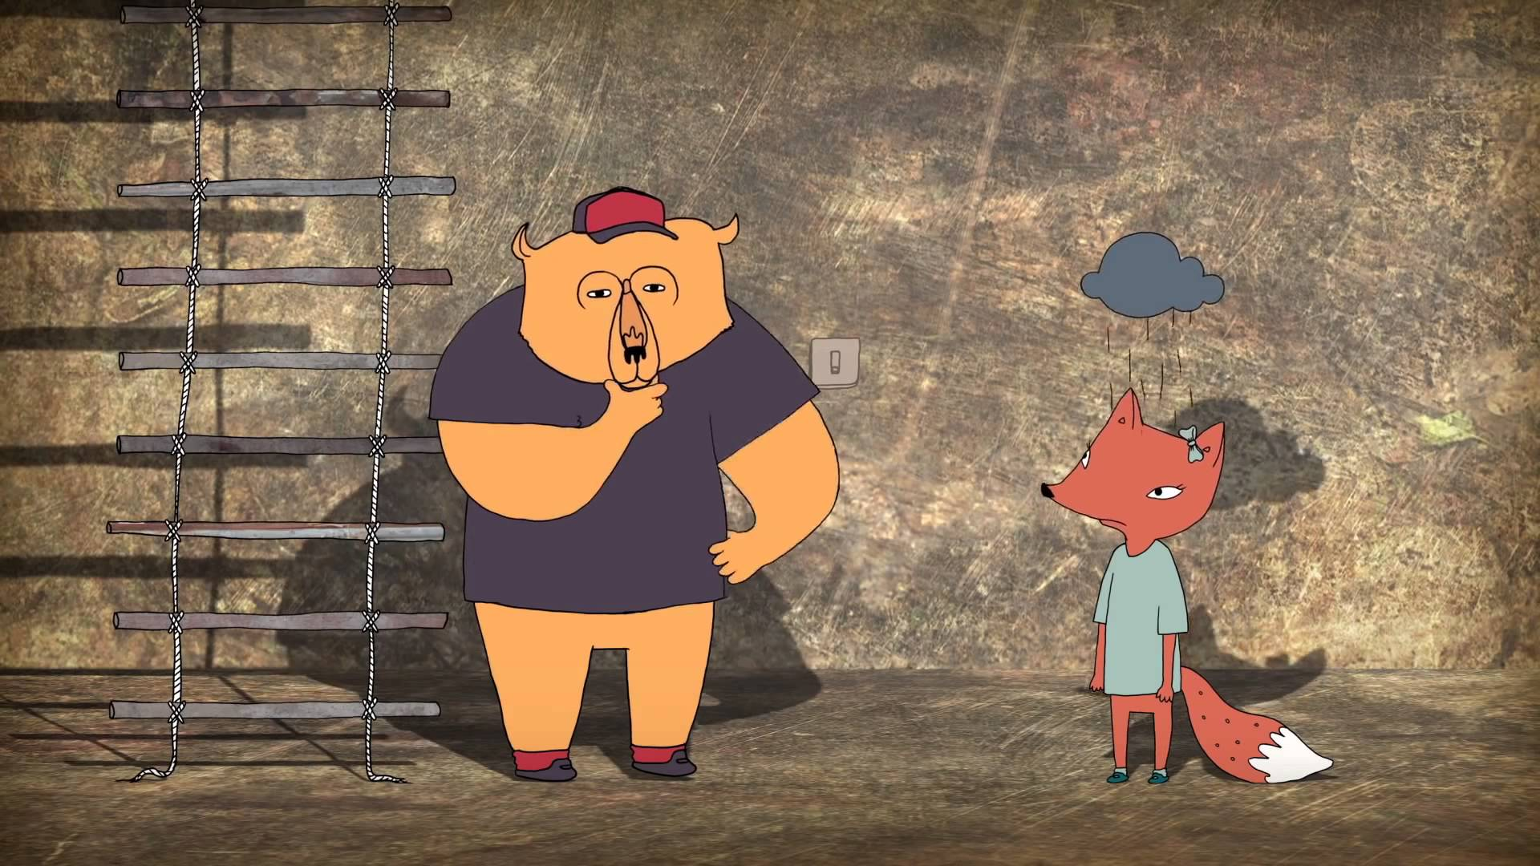
Lanark County Community Justice
613-264-1558 or 1-888-264-1558

Slide 18
Lanark County Community Justice
FIRST Introduce yourself and build rapport, trust and safety. Don’t rush into questioning.
Explain the entire process and invite them to ask as many questions as they want, whenever they want. Ask them if it’s ok if you take notes- offer them as much choice as possible, whenever possible.
Reassure them of confidentiality, that you’re not here to judge and we can take breaks if needed.
Be prepared to be patient, comfortable with BIG feelings and silence. Never supply a word to someone
613-264-1558 or 1-888-264-1558

Slide 19
Lanark County Community Justice
When trauma occurs, the prefrontal cortex will frequently shut down leaving the less advanced portions of the brain to experience and record the event.
Traumatic memory is fragmented, can’t provide narrative
misinterpreted as lying
Demeanor: lack of emotion or odd/ ”inappropriate” affect
misinterpreted as lying or “not being upset”
Sensory memories may be more detailed
613-264-1558 or 1-888-264-1558

Slide 20
Lanark County Community Justice
Affect or Emotion
Visual Images
Meaning-Making
Behaviours/ Reactions
Bodily Sensations
Parts of Memory
613-264-1558 or 1-888-264-1558

Slide 21
Lanark County Community Justice
613-264-1558 or 1-888-264-1558

Slide 22
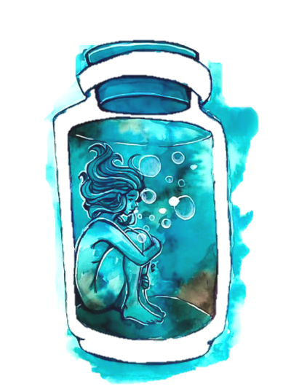
Lanark County Community Justice
Can you tell me what upsets you the most about what happened?
613-264-1558 or 1-888-264-1558
Notes:
Think of this question as how you uncork the bottle. Once we’ve dealt with the thing that’s upsetting them the most, we can see how much more easily the rest comes out.

Slide 23
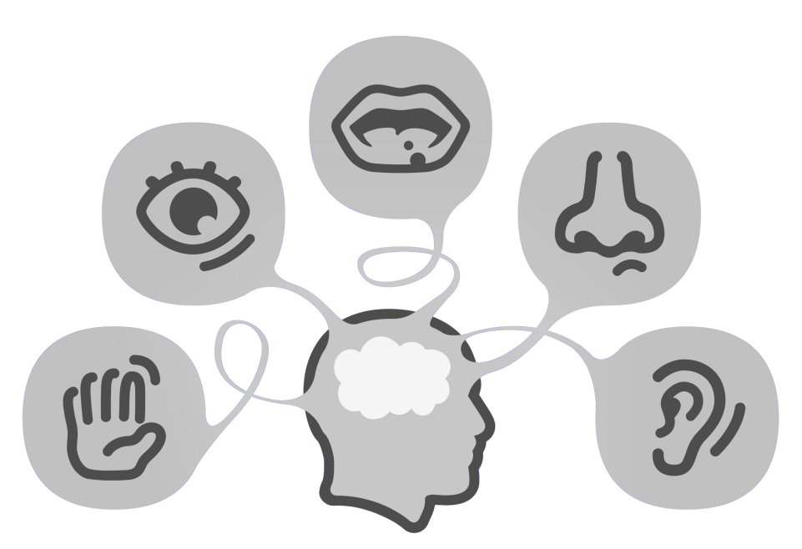
Lanark County Community Justice
Ask questions using sensory anchors before cognitive questions:
Can you remember any smells, sounds?
Was it warm, cold, raining
(sometimes asking about the weather, the clothes/decorations can help recall timing of an event
What did that feel like?
THEN ask what they were thinking when that happened
Avoid asking “Why did you…” or “Why didn’t you…” as it often feels like blaming to the victim
613-264-1558 or 1-888-264-1558

Slide 24
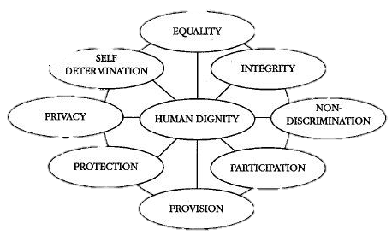
Lanark County Community Justice
C
R
E
D
O
ompassion
espect
mpathy
ignity
peness
613-264-1558 or 1-888-264-1558

Slide 25
Lanark County Community Justice
Please remember self-care is for you as well as the person you are supporting
Come to Sheri, Andrew or Sarah with anything that feels heavy or intense to debrief and get supported
613-264-1558 or 1-888-264-1558

Slide 26
Lanark County Community Justice
613-264-1558 or 1-888-264-1558

